Slide 1
ARM Part-II
September 2021

Slide 2
Many of today’s most popular 32-bit microcontrollers use RISC technology. Unlike CISC processors, RISC engines generally execute each instruction in a single clock cycle, which typically results in faster execution than on a CISC processor with the same clock speed.
Increased performance, however, comes at a price: a RISC processor typically needs more memory than a CISC does to store the same program. Many of the complex functions performed in a single, slow, instruction in a CISC processor may require two, three, or more simpler instructions in a RISC.
Except in the most speed-critical of embedded devices, the cost of memory is much more critical than the execution speed of the processor. To reduce memory requirements and, thereby, cost, Advanced RISC Machines (ARM) created the Thumb instruction set as an option for their RISC processor cores. The most well-known chip that includes the Thumb instruction set is the ARM7TDMI. The “T” in the core’s full name specifies Thumb.

Slide 3
Getting into Thumb Mode.
Core has two execution states ARM and Thumb;
Thumb is a compressed and 16 bit representation of a subset of the ARM instruction set.
Like ARM, Thumb also uses load store architecture for data processing, data transfer and control flow instructions.
The standard chip that includes the Thumb instruction set is the ARM7TDMI where "T" specifies Thumb. (Remember this, we saw this in CPSR ;))
ARM by Shriram

Slide 4
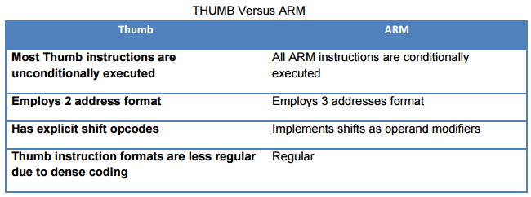
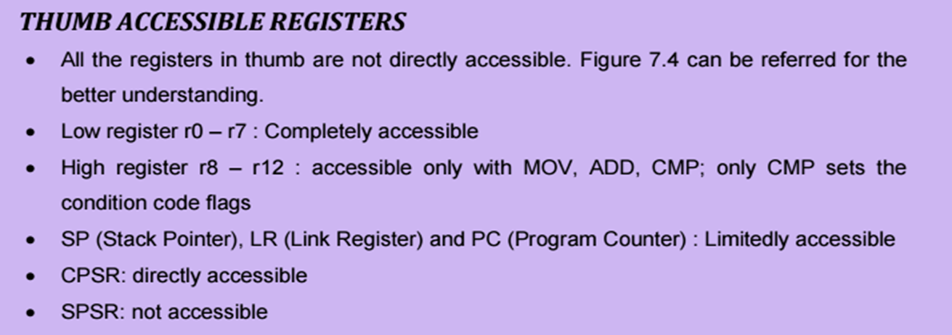
ARM by Shriram

Slide 5
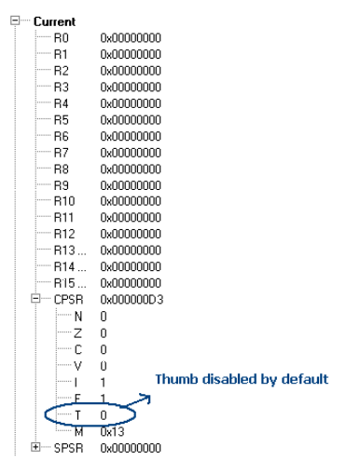
How to set thumb state?
D3 is the default value for the CPSR as shown in the below. So by default one can observe that the Thumb state is disabled. To get it enabled, as already discussed CPSR should be accessed and T bit should be set.
ARM by Shriram

Slide 6
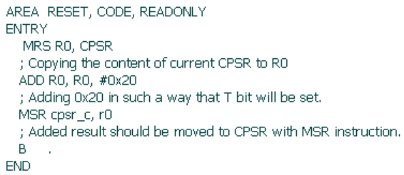
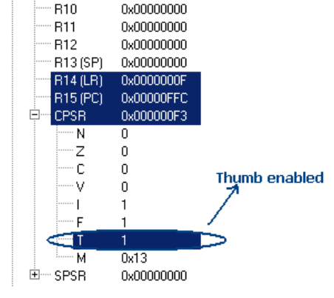
Setting the T bit can be done by adding 0x20 to the D3. It will then set the T bit and eventually the THUMB mode will be set
ARM by Shriram

Slide 7
Try these all with ARM.
1. Write a program to find greatest of three numbers.
2. Write a program to SWAP two values without using the third variable.
3. Write a simple code to find out if a number is prime or not.
4. Write a program to SWAP upper and lower nibbles of a number.
5. Write a program to disassemble a value. E.g. 54H to 05H and 04H.
6. Write a program to convert ASCII value to BINARY.
7. Write a program to convert HEXADECIMAL to BINARY.
8. Factorial of a given number.
9. Fibonacci series.
10. Prime number or not.
11. Sorting the numbers in a series.
ARM by Shriram

Slide 8
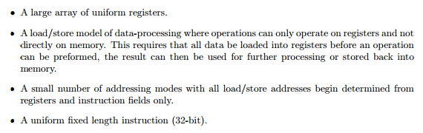
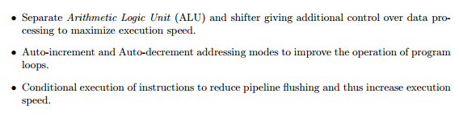

Recollect all these
ARM by Shriram

Slide 9
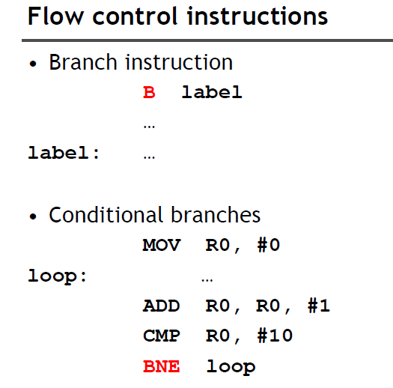

Slide 10
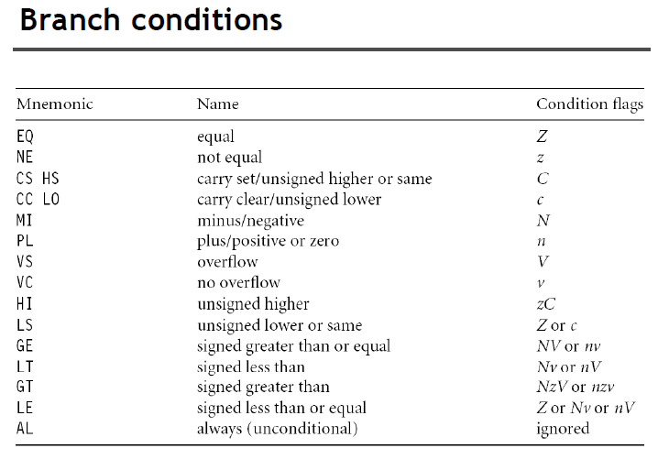

Slide 11
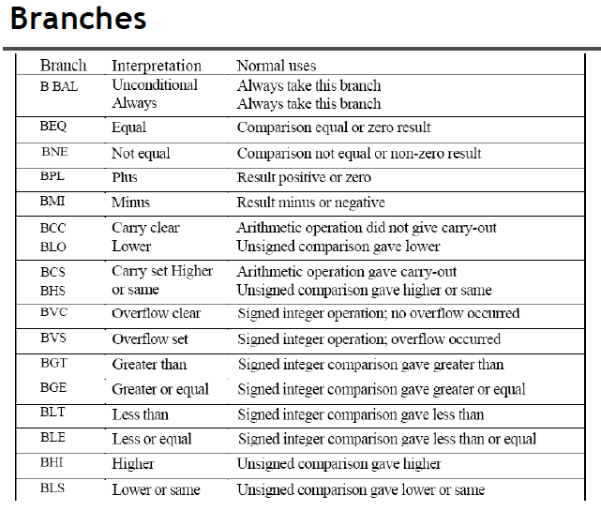

Slide 12
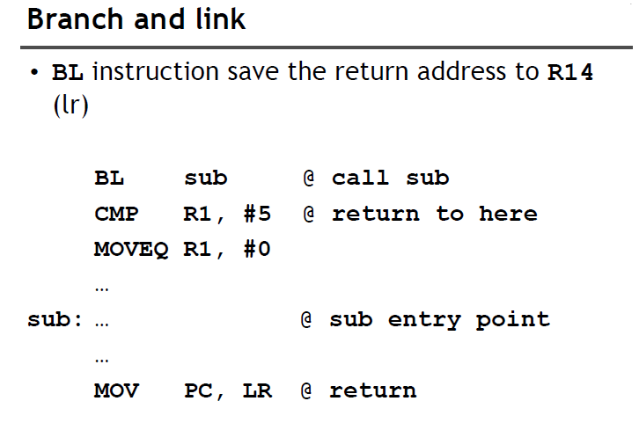
Note that since the return address is held in a register, the subroutine should not call a further, nested, subroutine without first saving r14, otherwise the new return address will overwrite the old one and it will not be possible to find the way back to the original caller.

Slide 13
A stack is usually implemented as a linear data structure which grows up (an ascending stack) or down (a descending stack) memory as data is added to it and shrinks back as data is removed.
A stack pointer holds the address of the current top of the stack, either by pointing to the last valid data item pushed onto the stack (a full stack), or by pointing to the vacant slot where the next data item will be placed (an empty stack).

Slide 14
The ARM multiple register transfer instructions support all four forms of stack:
Full ascending: the stack grows up through increasing memory addresses and the base register points to the highest address containing a valid item.
Empty ascending: the stack grows up through increasing memory addresses and the base register points to the first empty location above the stack.
Full descending: the stack grows down through decreasing memory addresses and the base register points to the lowest address containing a valid item.
Empty descending: the stack grows down through decreasing memory addresses and the base register points to the first empty location below the stack.

Slide 15
The block copy views are illustrated in the next slide, which shows how each variant stores three registers into memory and how the base register is modified if auto-indexing is enabled.
The base register value before the instruction is r9, and after the auto-indexing it is r9'.

Slide 16
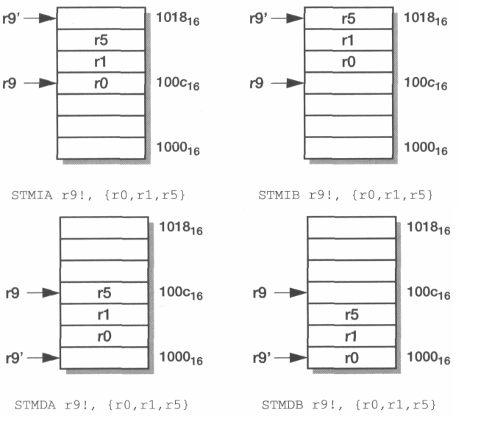

Slide 17
To illustrate the use of these instructions, here are two instructions which copy eight words from the location r0 points to to the location r1 points to:
LDMIA r0!, {r2-r9}
STMIA r1, {r2-r9}
After executing these instructions r0 has increased by 32 since the '!' causes it to auto-index across eight words, whereas r1 is unchanged.
If r2 to r9 contained useful values, we could preserve them across this operation by pushing them onto a stack:
STMFD r13!, {r2-r9} ; save regs onto stack
LDMIA r0!, {r2-r9}
STMIA r1, {r2-r9}
LDMFD r13!, {r2-r9} ; restore from stack

Slide 18
Here the 'FD' postfix on the first and last instructions signifies the full descending stack address mode as described earlier.
Note that auto-indexing is almost always specified for stack operations in order to ensure that the stack pointer has a consistent behaviour.
The load and store multiple register instructions are an efficient way to save and restore processor state and to move blocks of data around in memory.
They save code space and operate up to four times faster than the equivalent sequence of single register load or store instructions (a factor of two due to improved sequential behaviour and another factor of nearly two due to the reduced instruction count).

Slide 19
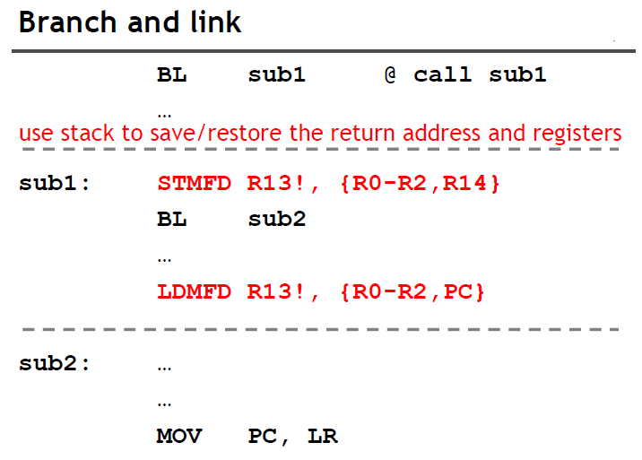
The normal mechanism used here is to push r14 onto a stack in memory.
Since the subroutine will often also require some work registers, the old values in these registers can be saved at the same time using a store multiple instruction
A subroutine that does not call another subroutine (a leaf subroutine) need not save r14 since it will not be overwritten.

Slide 20
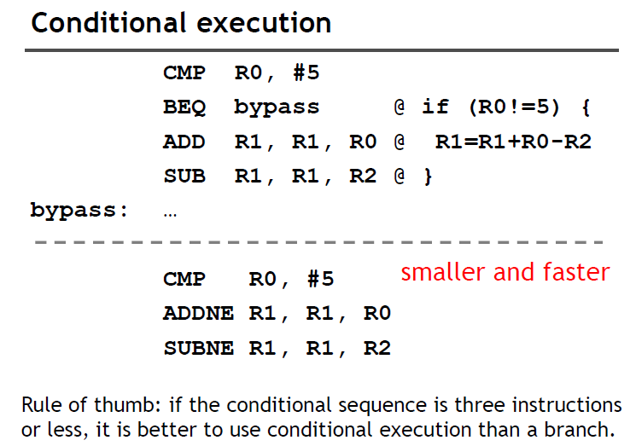

Slide 21
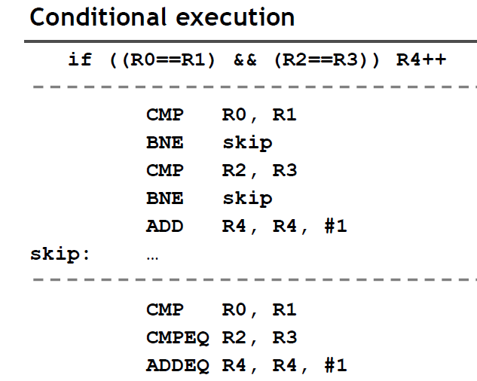

Slide 22
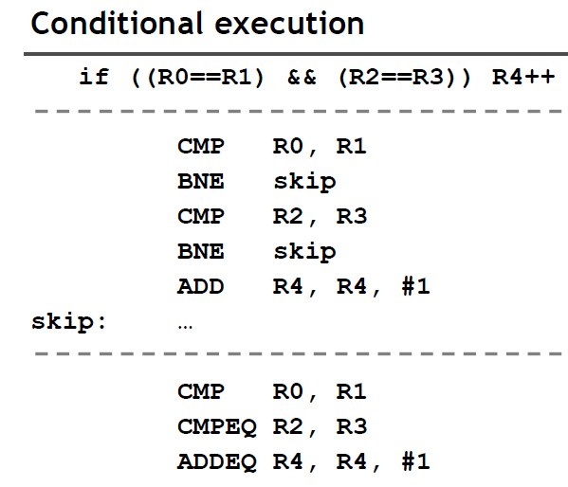

Slide 23
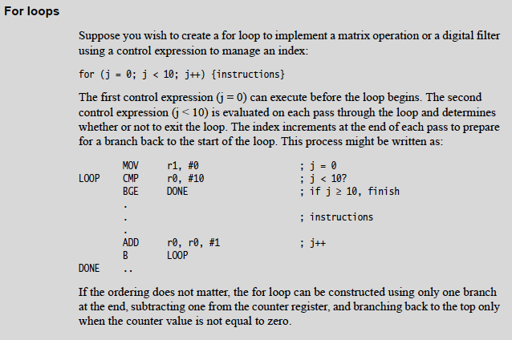
FOR LOOP – An Example code.

Slide 24
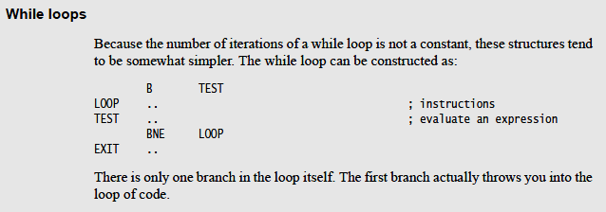
While Loop

Slide 25
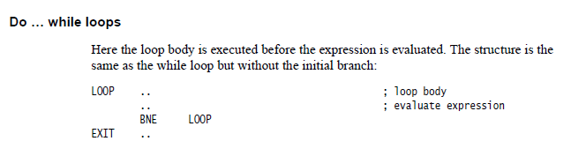
Do while

Slide 26
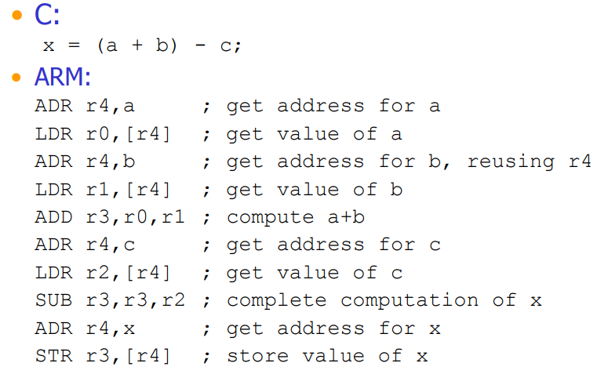

Slide 27
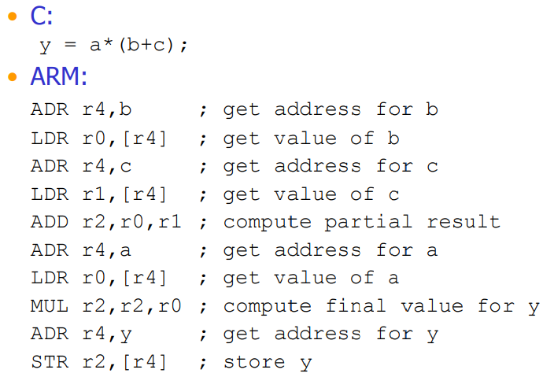

Slide 28
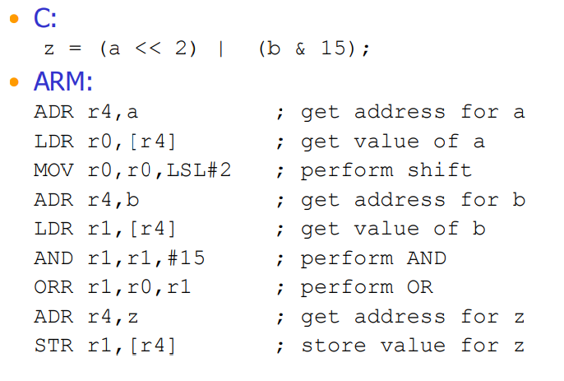

Slide 29
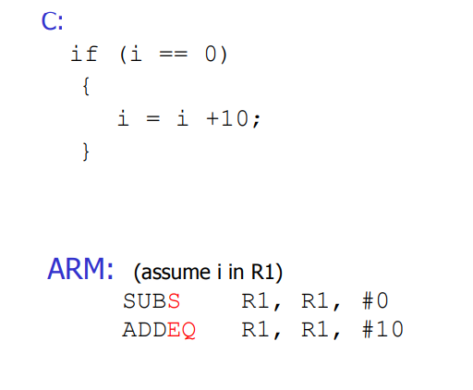

Slide 30
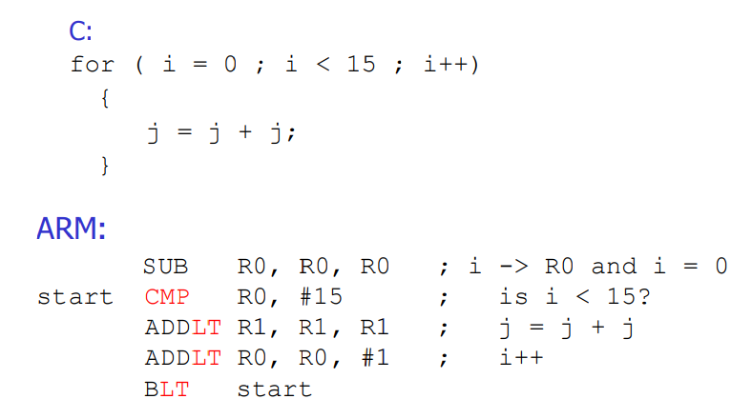

Slide 32
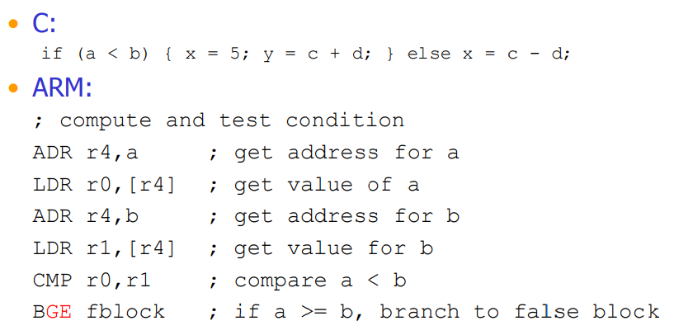

Slide 33
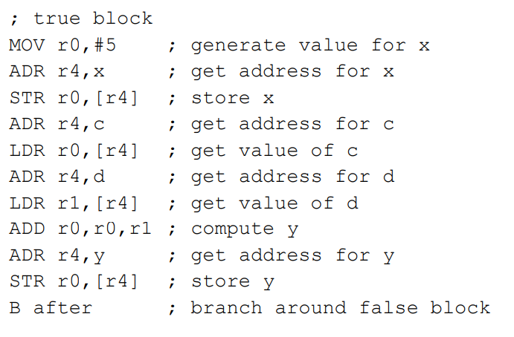

Slide 34
